Slide 1

Hotel Management System Analysis with SQL

Slide 2

OverView
The hotel industry relies on data to make informed decisions and provide a better guest experience. In
this internship, you will work with a hotel reservation dataset to gain insights into guest preferences,
booking trends, and other key factors that impact the hotel's operations. You will use SQL to query and
analyze the data, as well as answer specific questions about the dataset.

Slide 3
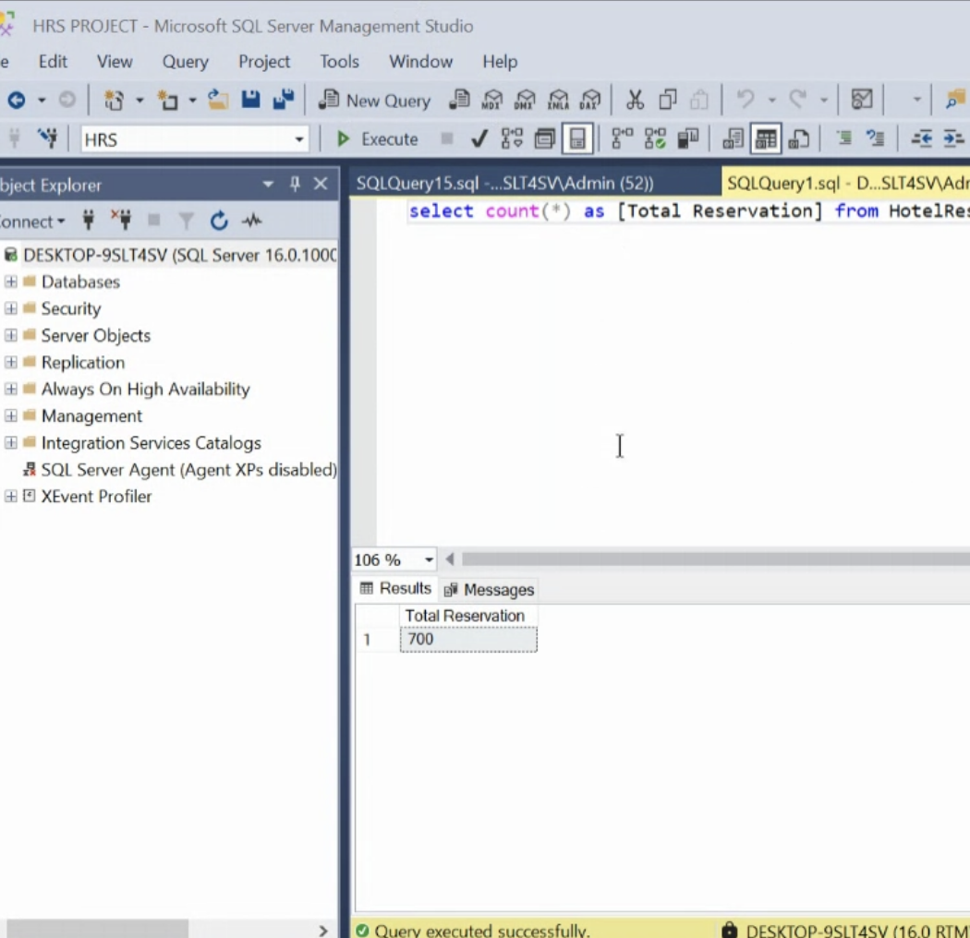
Query 1
What is the total number of reservations in the dataset?

Slide 4
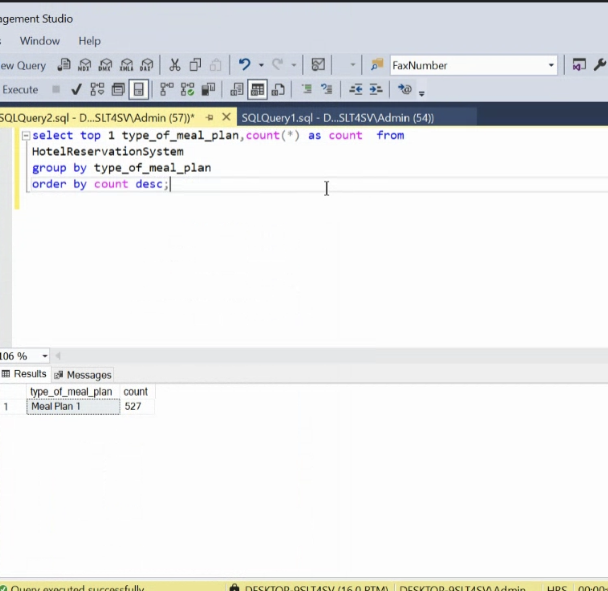
Query 2
Which meal plan is the most popular among guests?

Slide 5
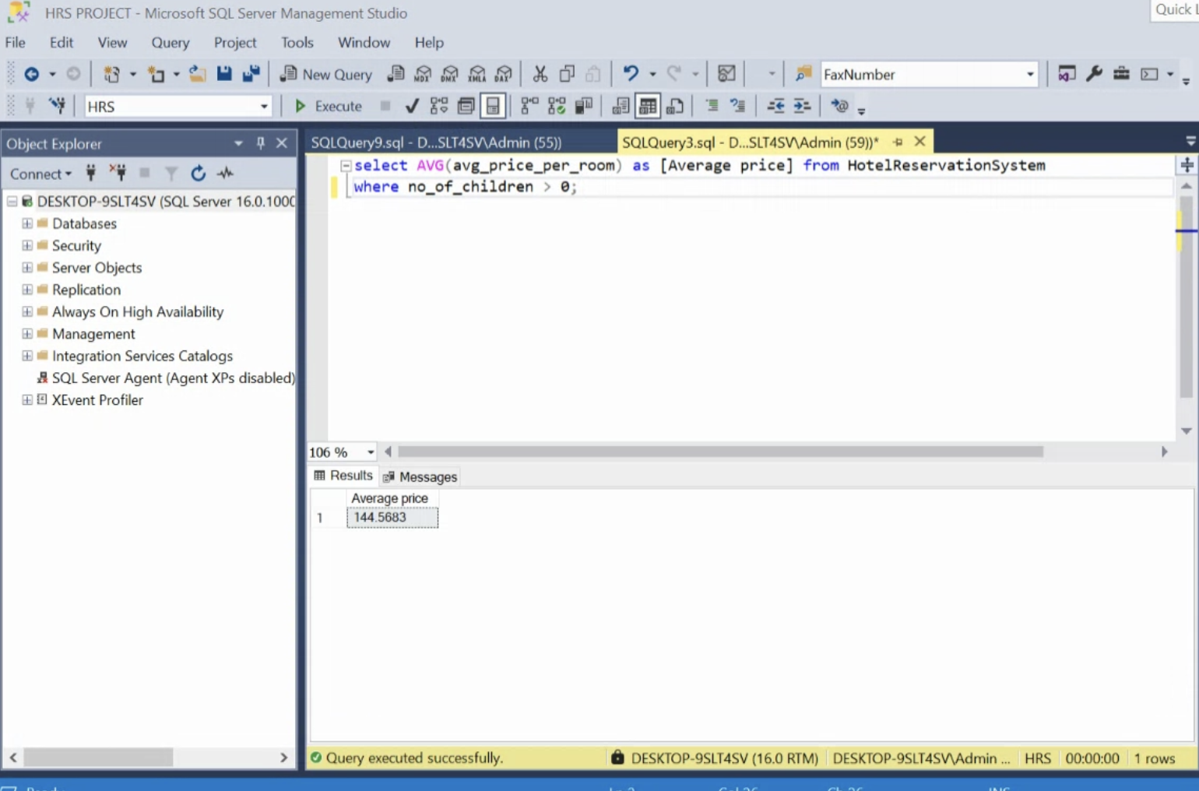
Query 3
What is the average price per room for reservations involving children?

Slide 6
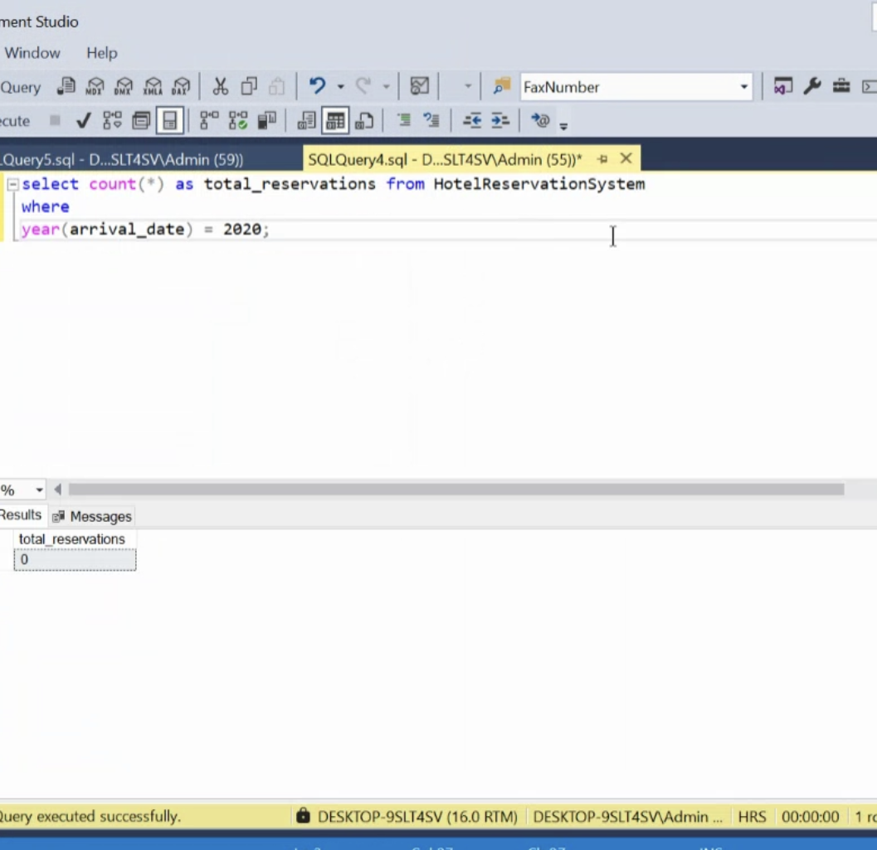
Query 4
How many reservations were made for the year 20XX (replace XX with the desired year)?

Slide 7
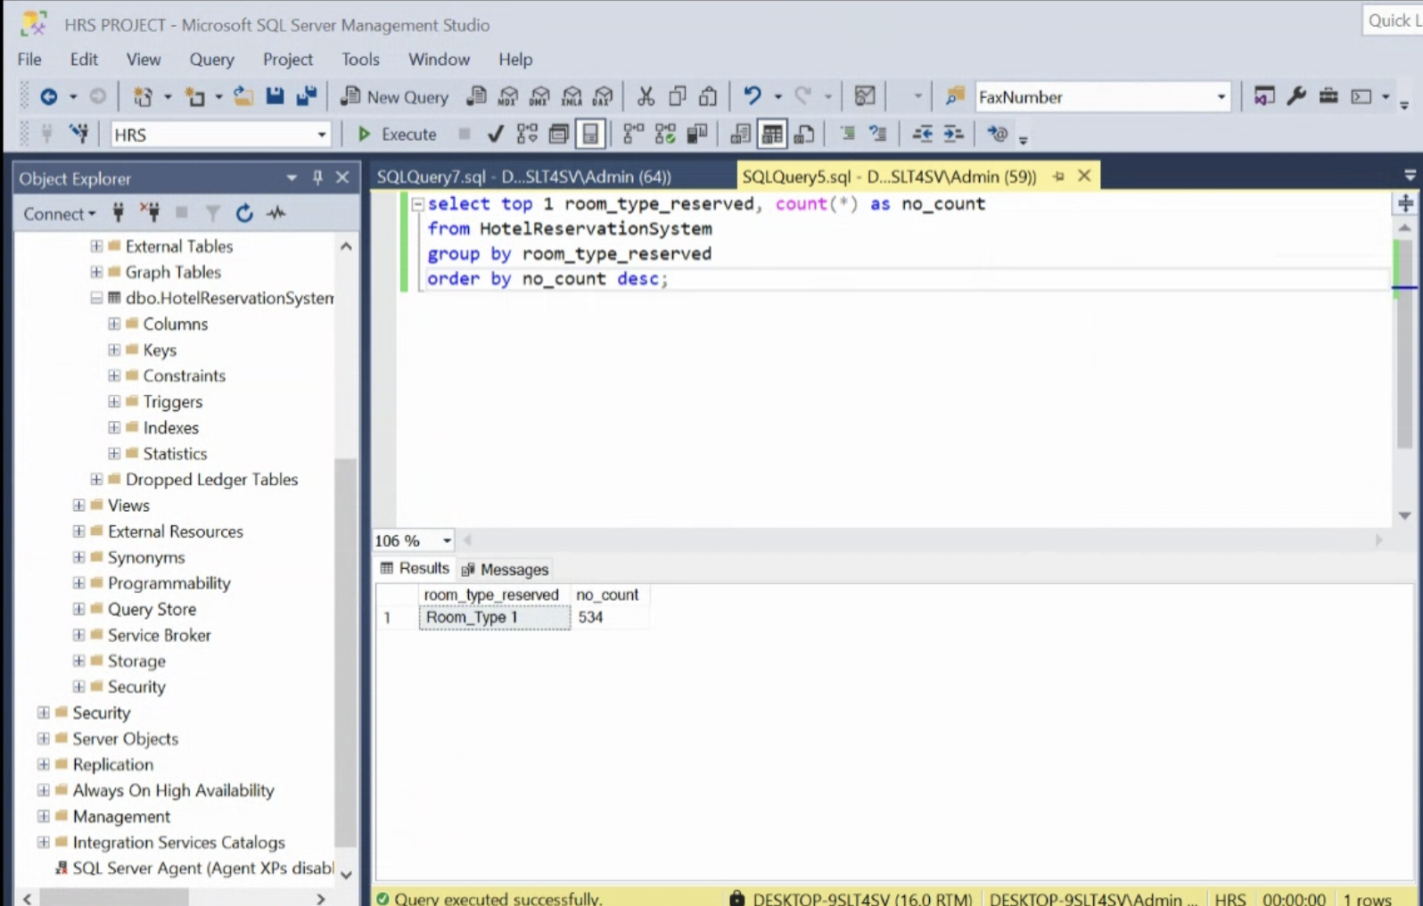
Query 5
What is the most commonly booked room type?

Slide 8
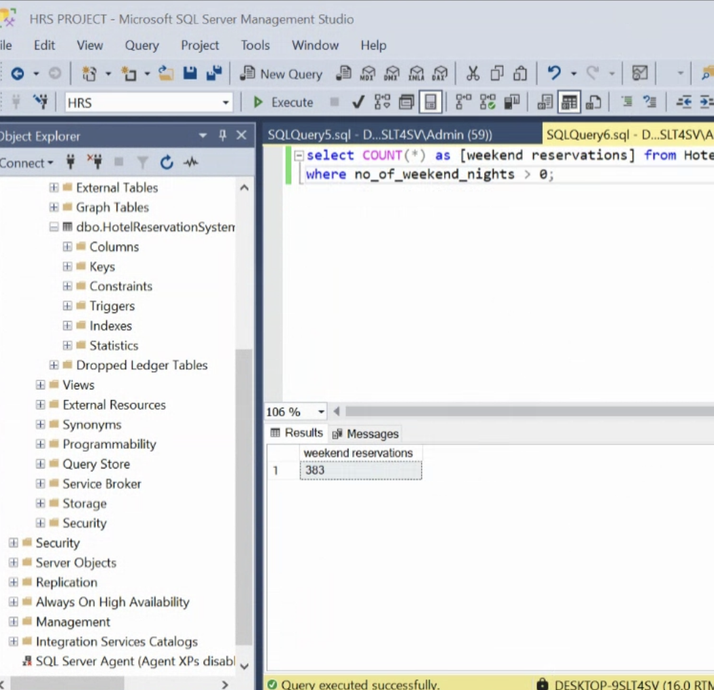
Query 6
How many reservations fall on a weekend (no_of_weekend_nights > 0)?

Slide 9
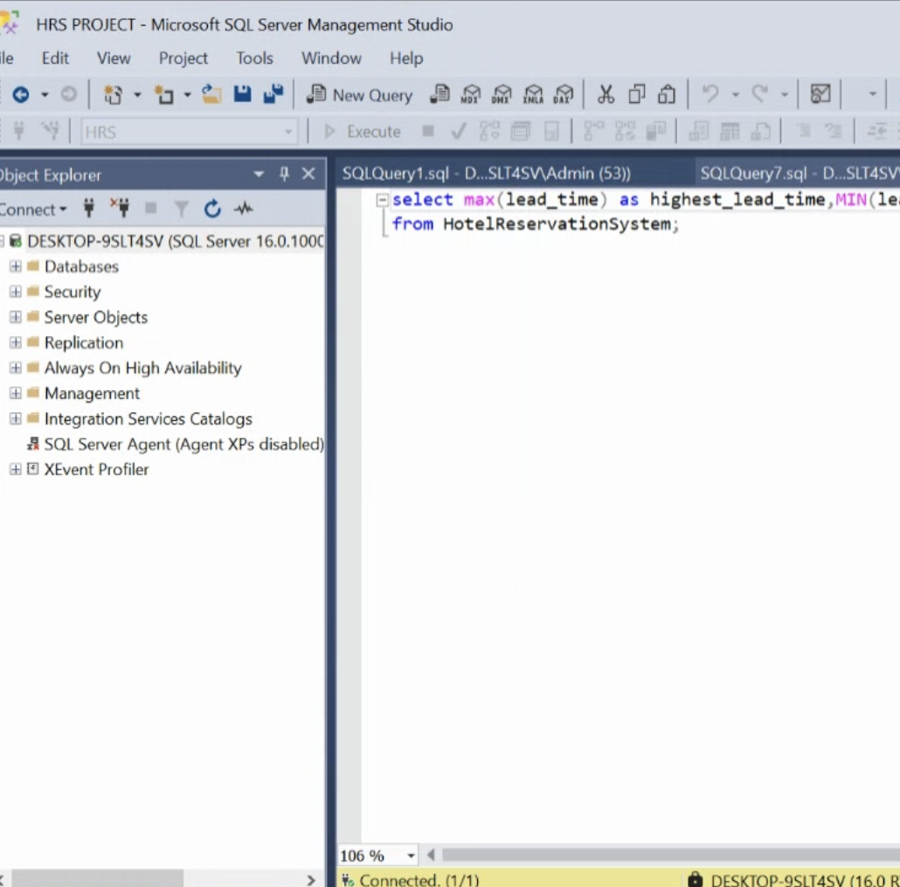
Query 7
What is the highest and lowest lead time for reservations?

Slide 10
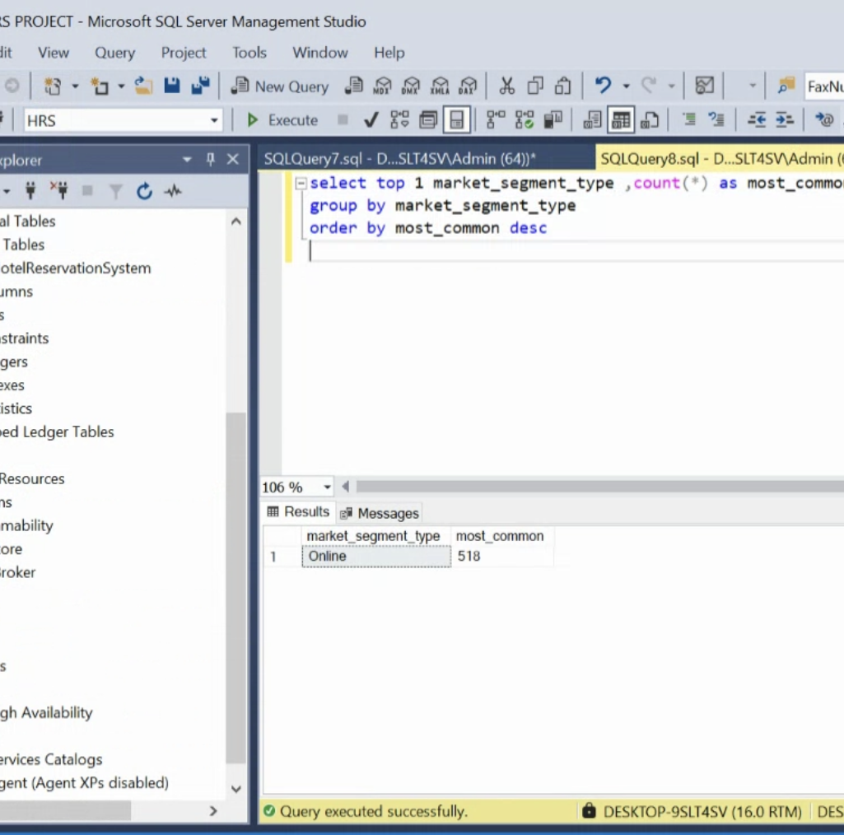
Query 8
What is the most common market segment type for reservations?

Slide 11
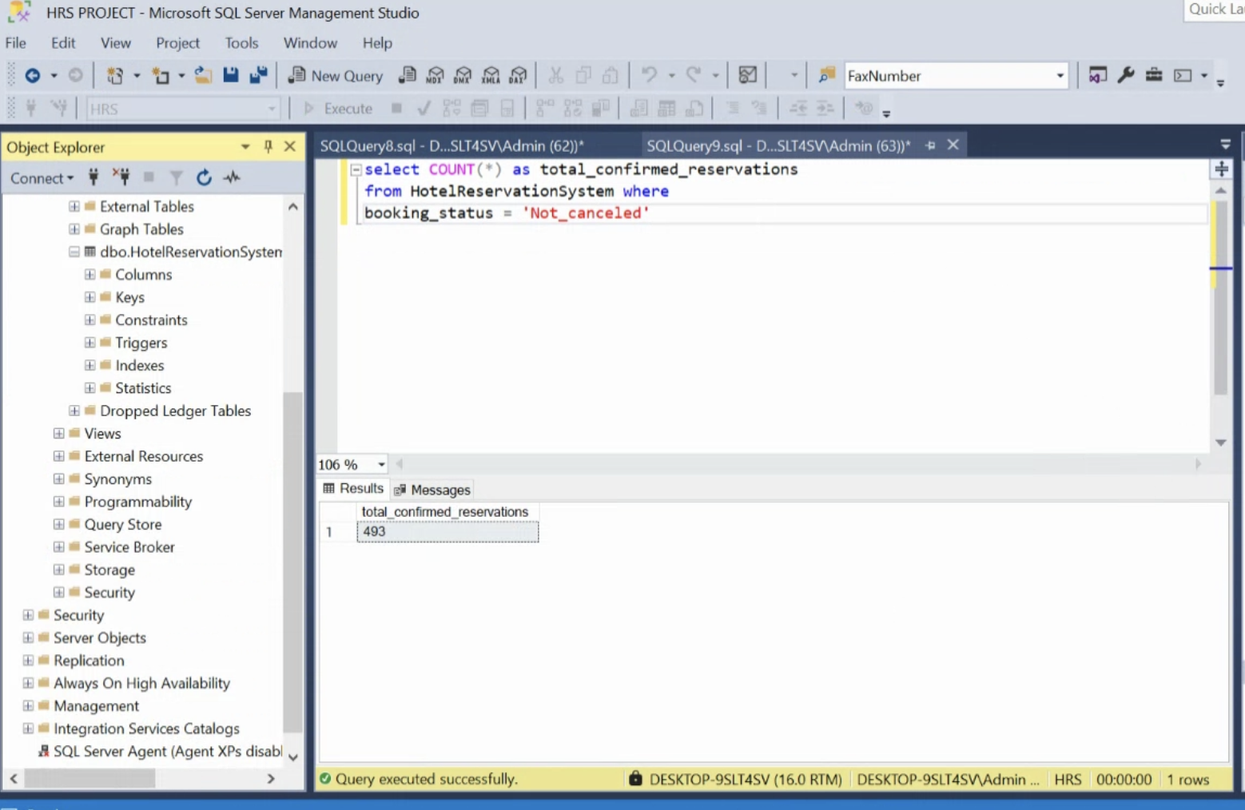
Query 9
How many reservations have a booking status of "Confirmed"?

Slide 12
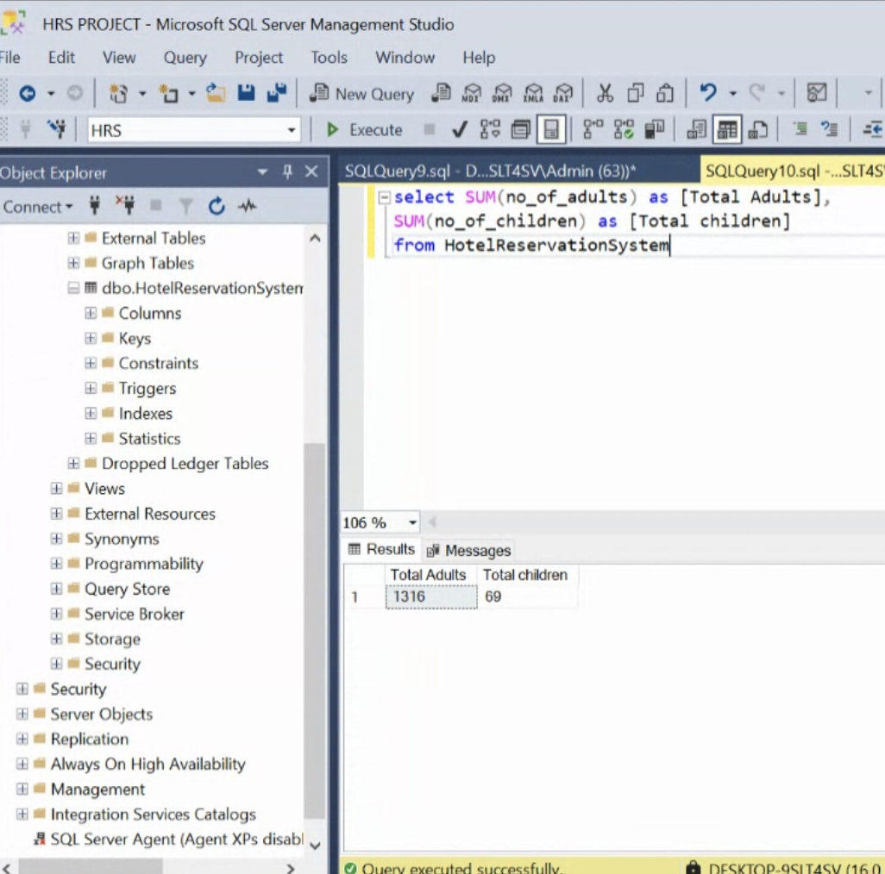
Query 10
What is the total number of adults and children across all reservations?

Slide 13
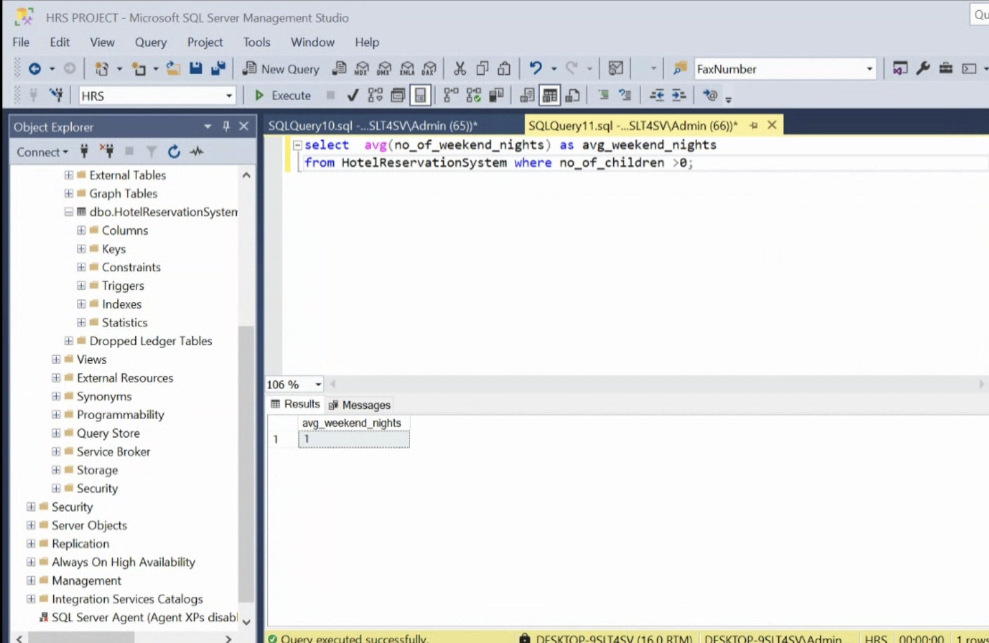
Query 11
What is the average number of weekend nights for reservations involving children?

Slide 14
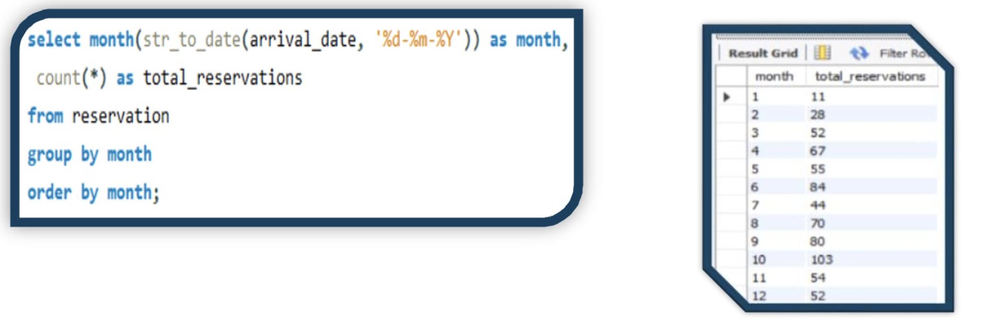
Query 12
How many reservations were made in each month of the year?

Slide 15

Query 13
What is the average number of nights (both weekend and weekday) spent by guests for each room type?

Slide 16
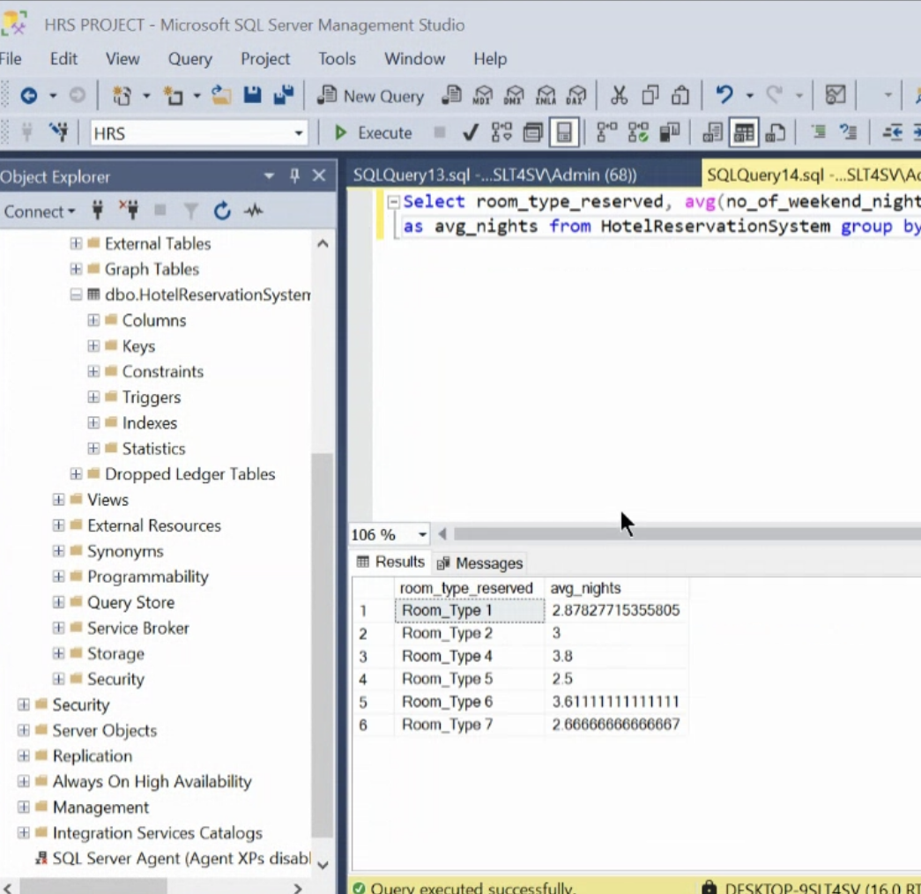
Query 14
For reservations involving children, what is the most common room type, and what is the average price for that room type?

Slide 17
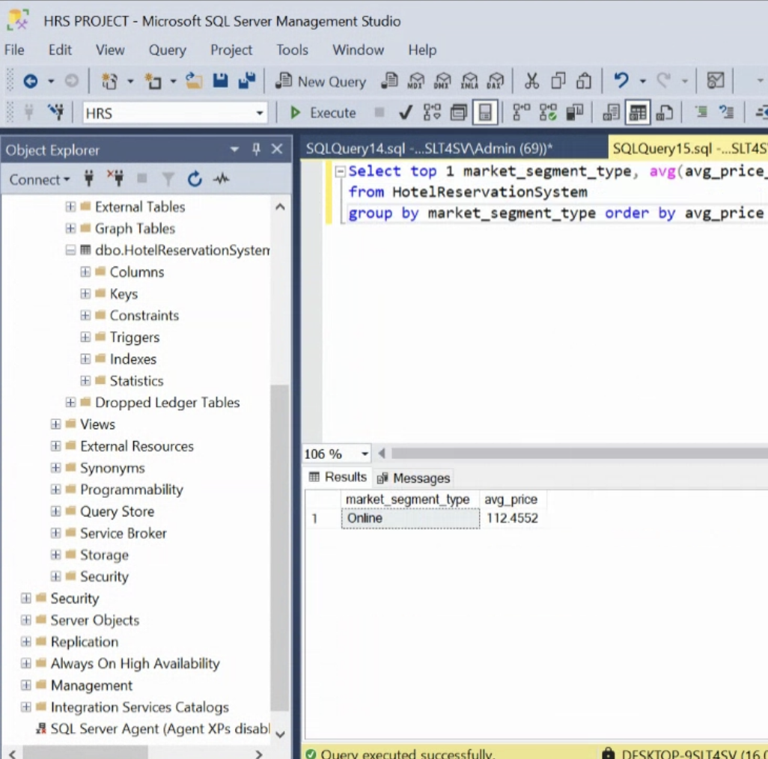
Query 15
Find the market segment type that generates the highest average price per room.

